Slide 1


Trigger Warning: Bloody Images
walks down
As a man the sidewalk, another guy in with him.
sun-kissed
walks
tandem
In the spirit of politeness, the man quickly glances to the right to acknowledge the guy, and sees he is covered in and .
muck
blood

Slide 2
walking faster
This frightens the man and he tries .
The keeps up with him,
bloodied guy
turns
so the man stops and to the guy.
“Why are you following me?” He says,
but when he looks at the guy,
reflection
he realizes it’s his in an office building.

Slide 3
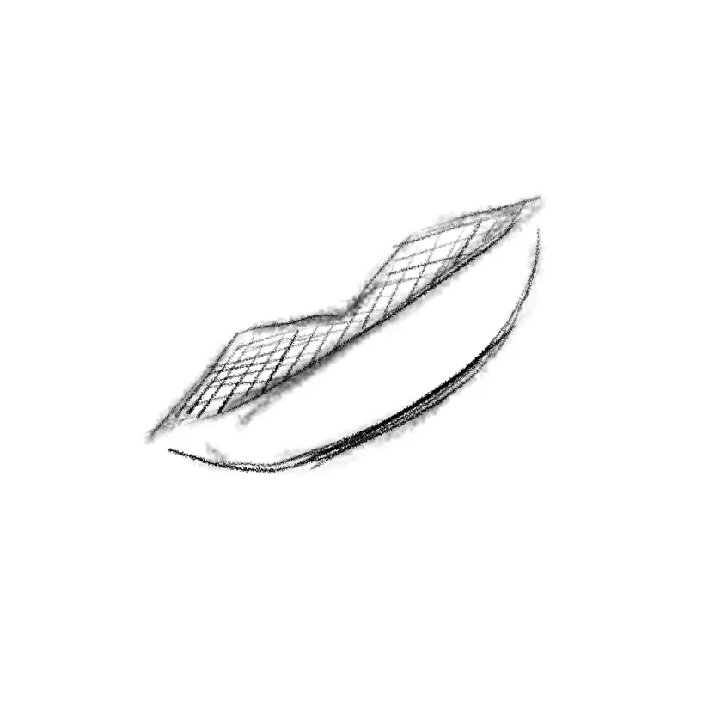
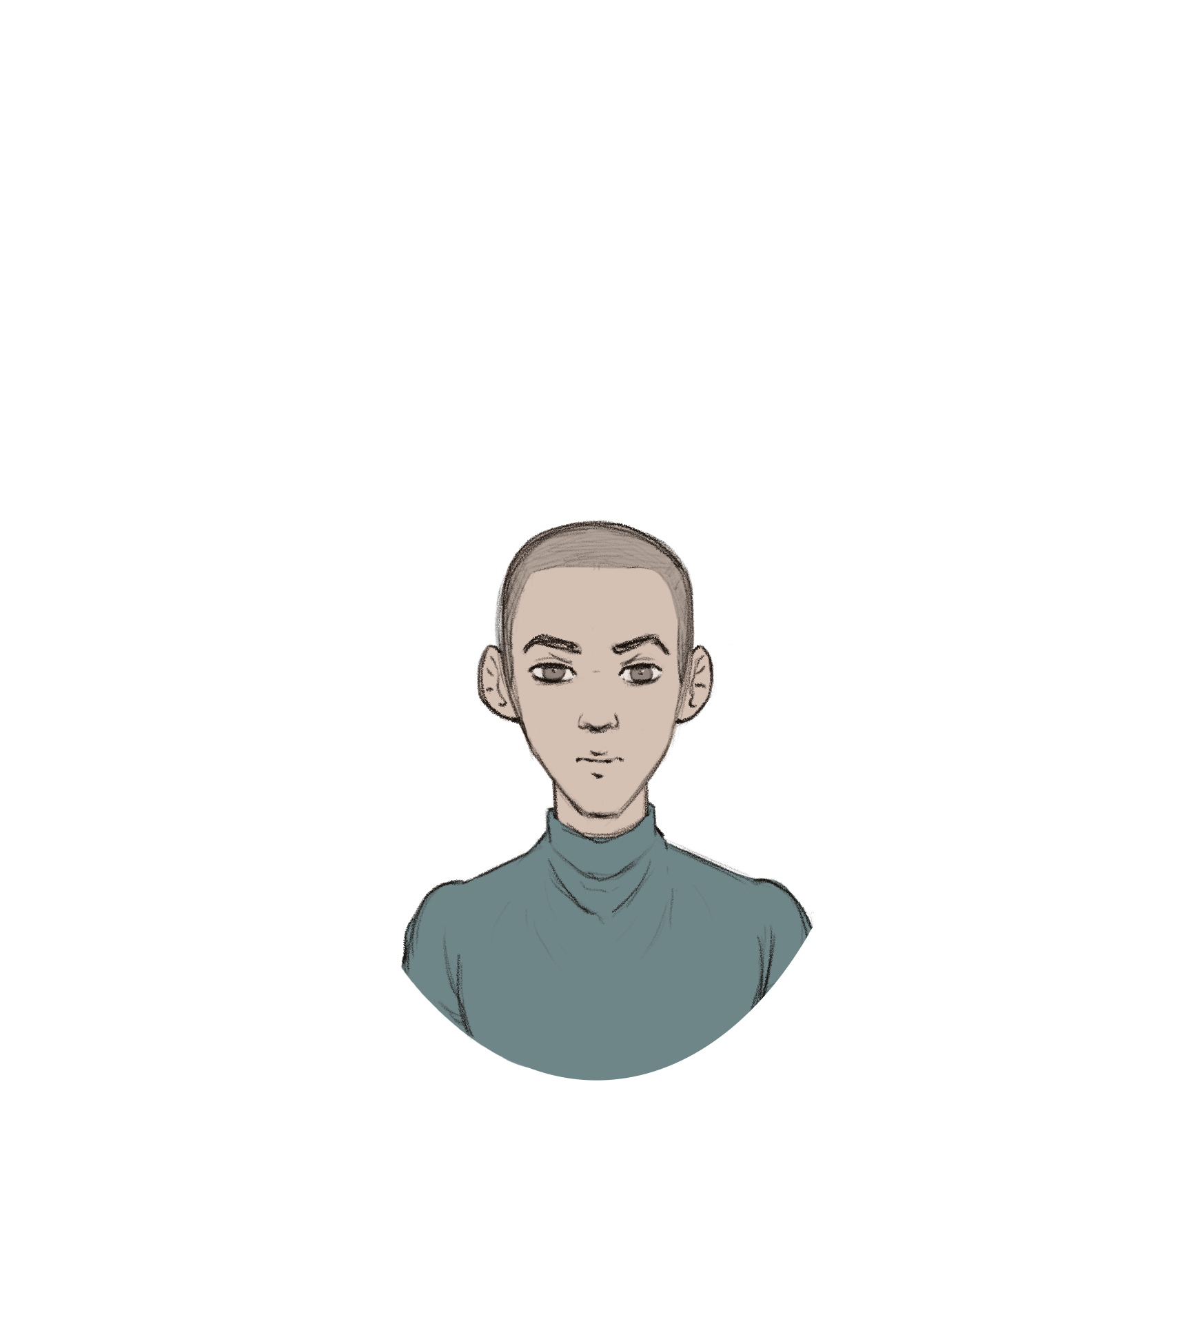
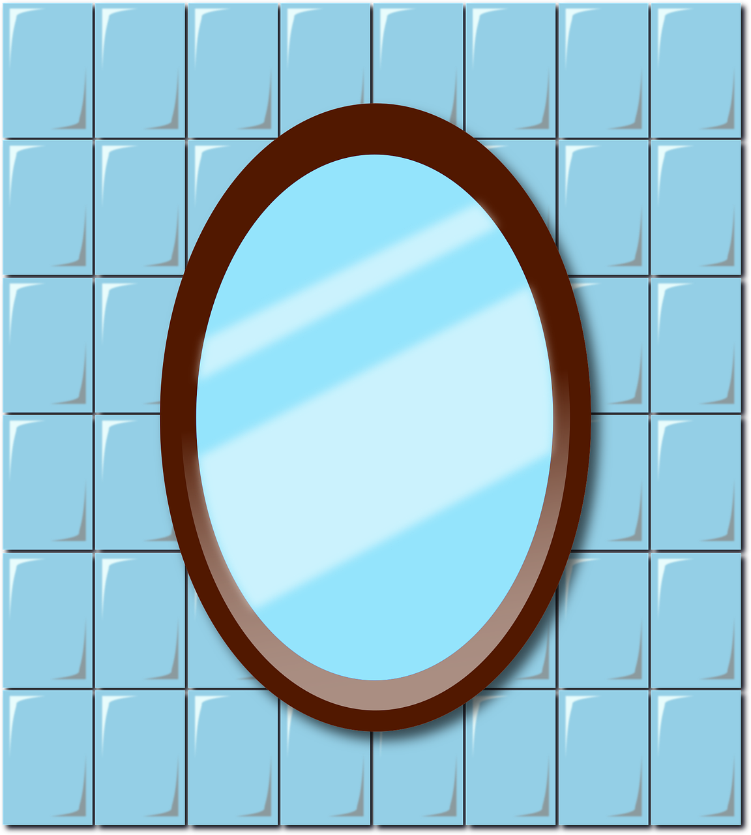
His reflection at him eerily,
smiles
scaring the man further,
run
causing him to home.​
When he arrived,
he looked in the bathroom mirror,
finding no fault with his .
reflection
The man takes a and relaxes, walking back to his white, couch.
deep breath
poofy

Slide 4
However, he discovers a small, -looking spot.
metallic-red
Was that there before? He thought.
Then, he caught more out of the corner of his eye:
metallic red
on his hand,
then on his other hand,
then all over his clothes.​

Slide 5
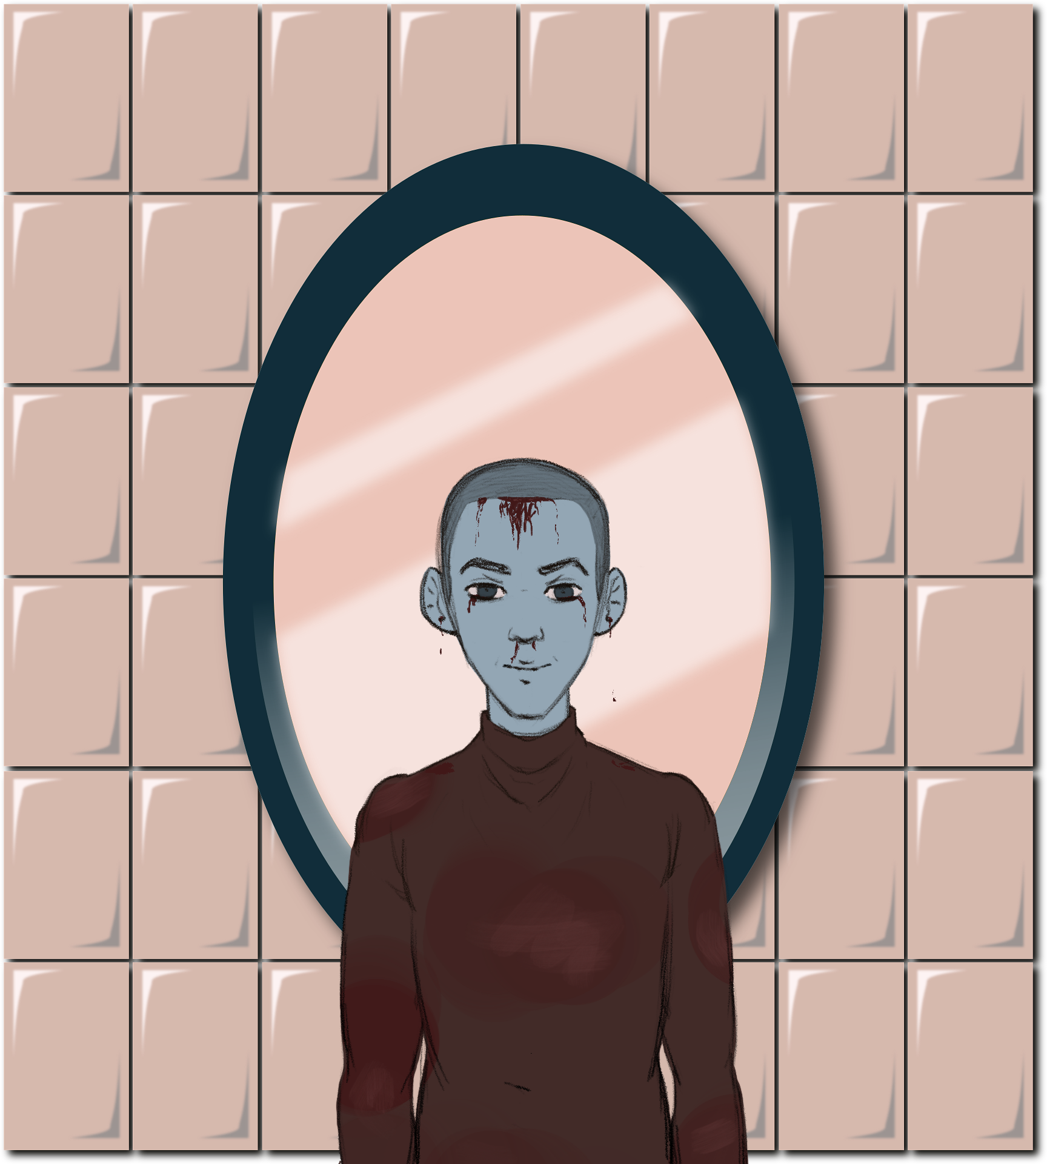
reflection
smiled
He looks at his in the window. His reflection .
“Looks like I’m you now,” his reflection said.
it was his actual body.
Except, it wasn’t his reflection:
This time,
he was trapped in the reflection.​

Slide 6

“H-how? Wh-“ the man shakily uttered before being interrupted.
“Why? Well, repressed memories surface eventually.
Don’t they?"

